Slide 1


Transcriptome analysis
Mohamed Emam Mansour
PhD student, Faculty of Science, University Porto university, Portugal

Slide 2
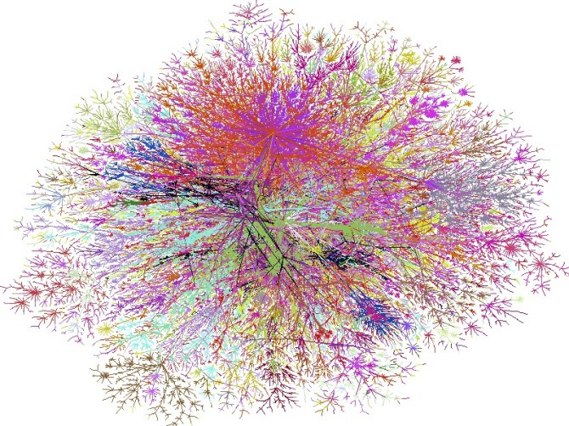
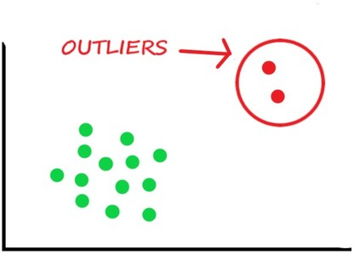


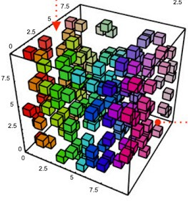

Challenges of omics analysis
Biological systems complexity
High biological variables
Outlier samples
Missing data
High data dimensionality
low number of samples
Mo et al., 2021
2

Slide 3
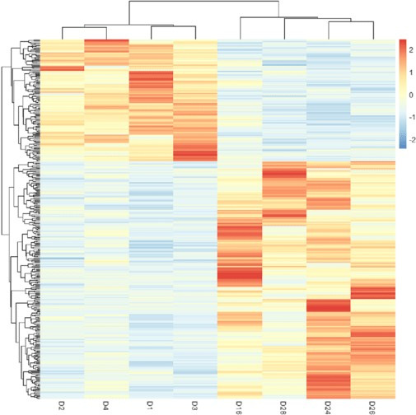
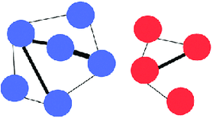
Purpose of omics analysis
Inference sources of variability
Identify samples subgroups
Schuurman et al., 2021

Slide 4






RNA-seq experiment overview
Healthy
SARS Cov2
mRNA isolation?

Slide 5
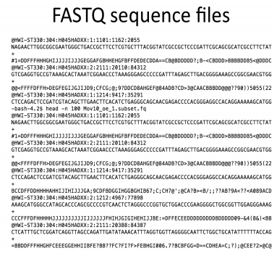
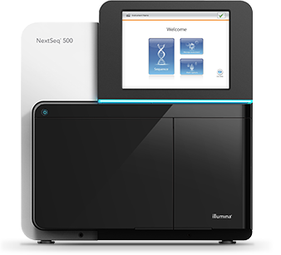
RNA-seq experiment
Library preparation
mRNA
mRNA fragmentation
Adaptors ligation
High throughput sequencer
(M Oweda 2020)

Slide 6
Fastqc format

Slide 7
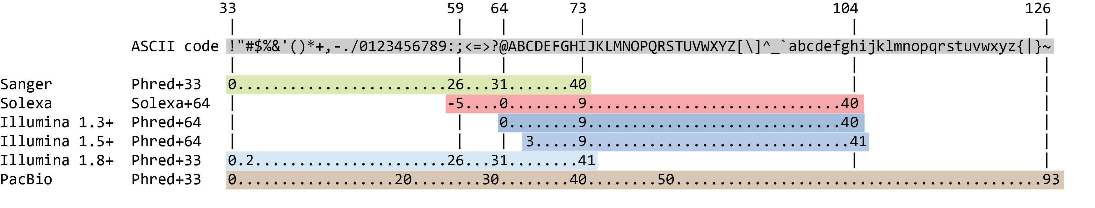
ASCII character

Slide 8
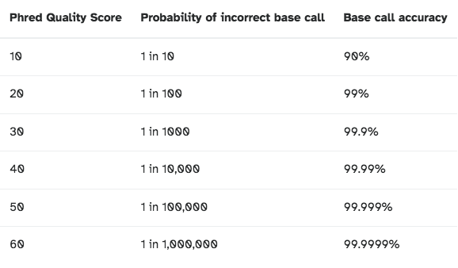
Phred score

Slide 9
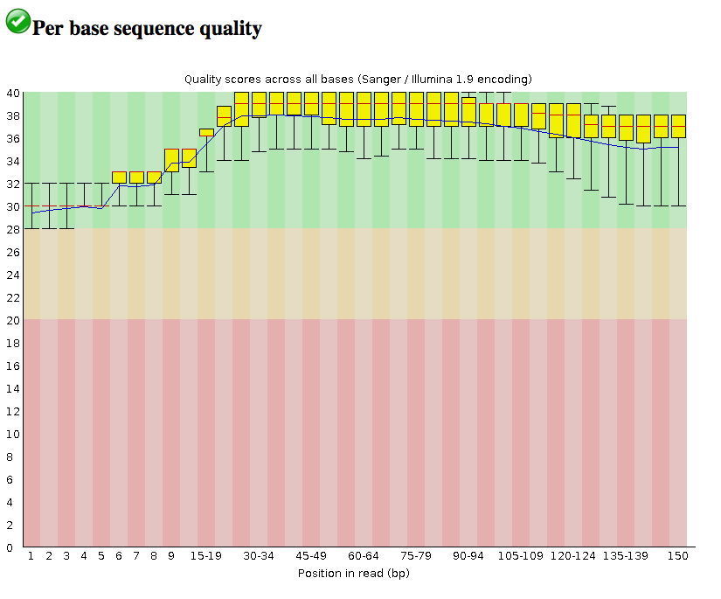
Fastqc report

Slide 10
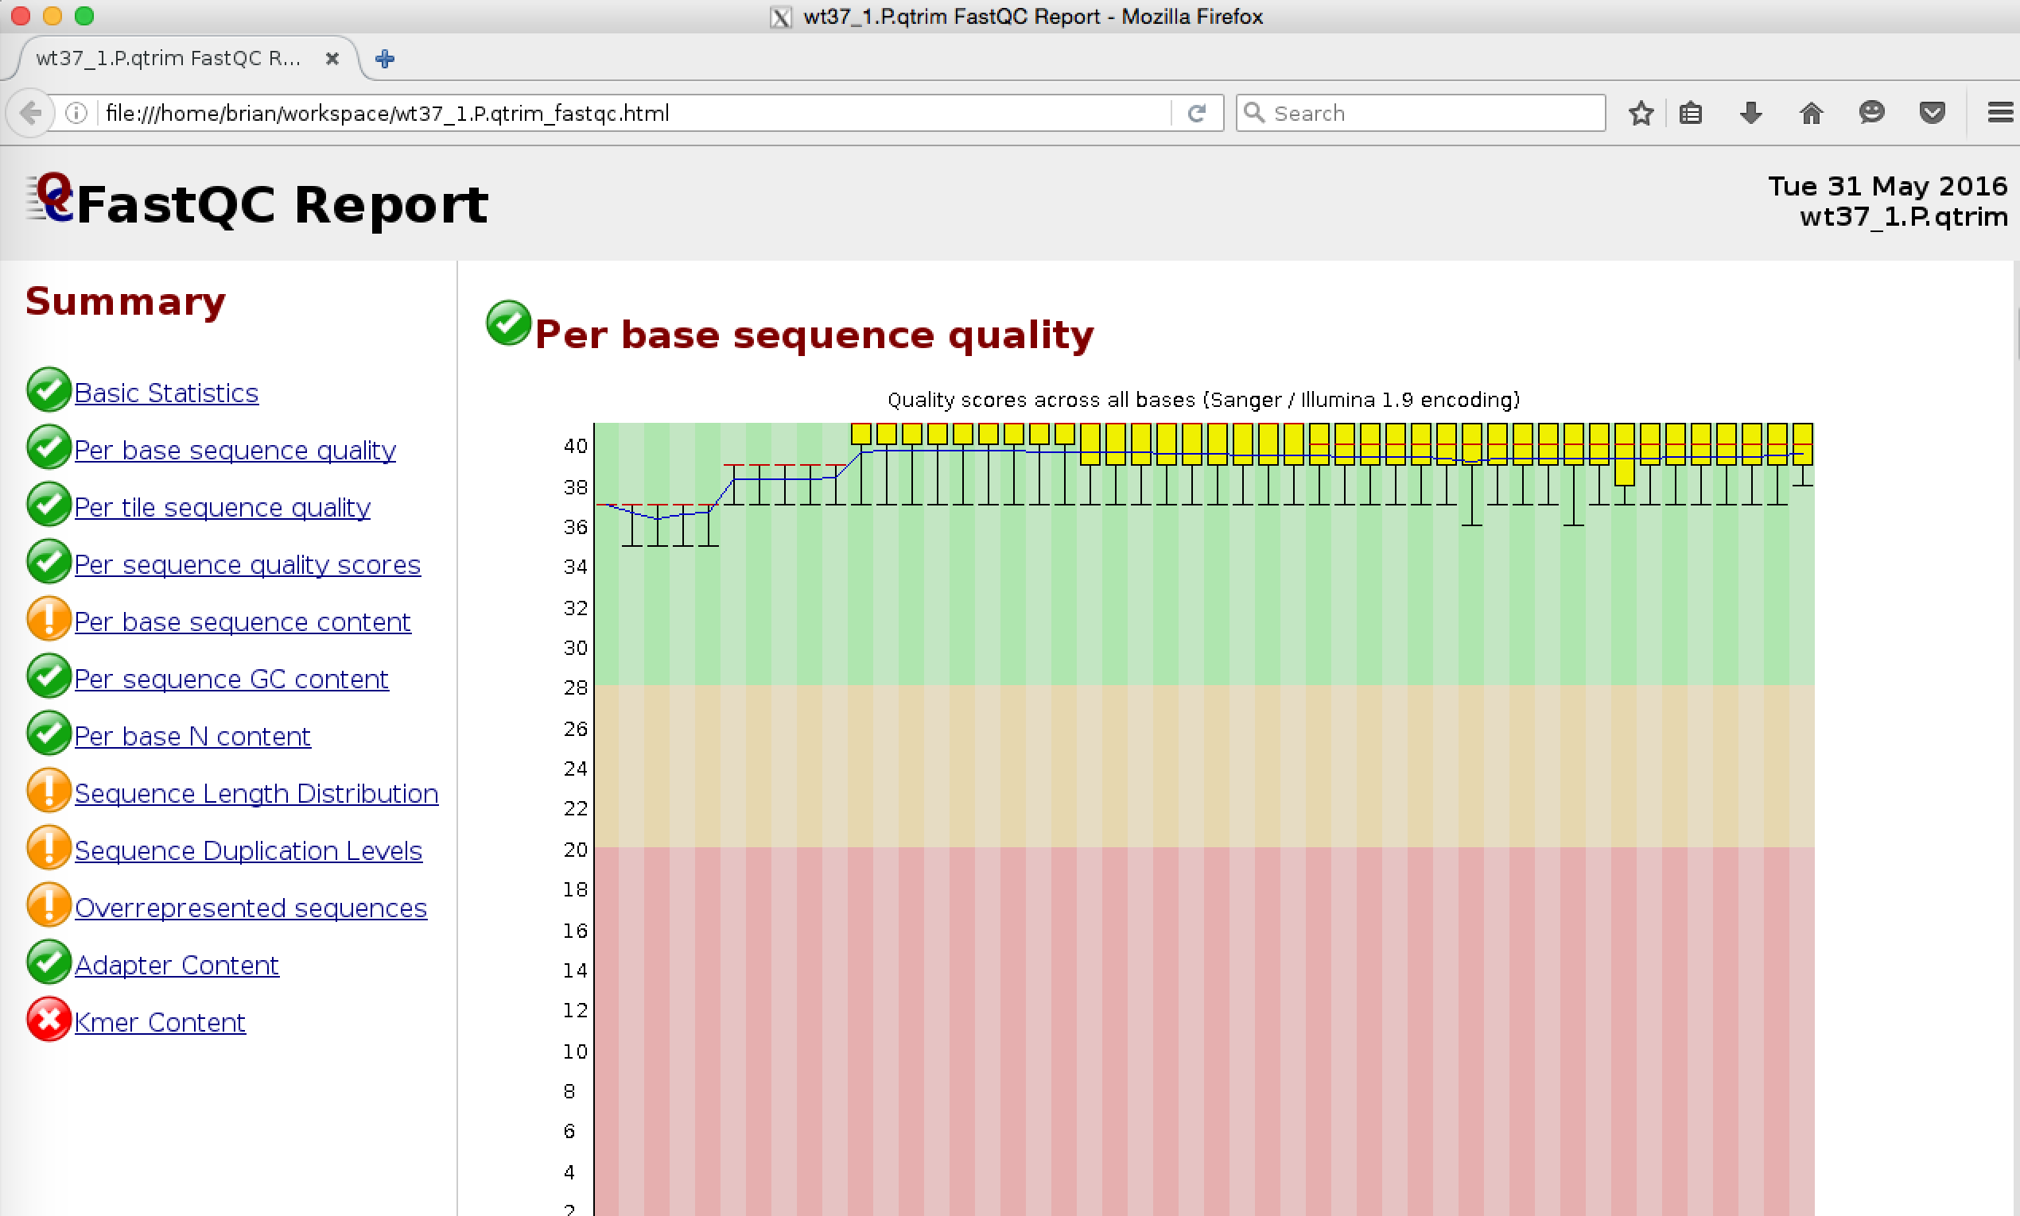
RNA-seq differential expression workflow
RNA-seq short reads
Quality control (FastQC)/Trimming
reference genome sequences (FASTA files)
Reads mapping to the genome
(STAR, GSNAP, TopHat)
annotations (GTF file)
FASTQ sequence reads
Reference genome
ATCGGACGTAGCACCTAGTTCCAGGTATGCCCTTGG
Reference genome + Annotation file
Gene 1
Gene 2
Gene 3
Gene 4
Sample 1
Sample 2
(M Oweda 2020)

Slide 11
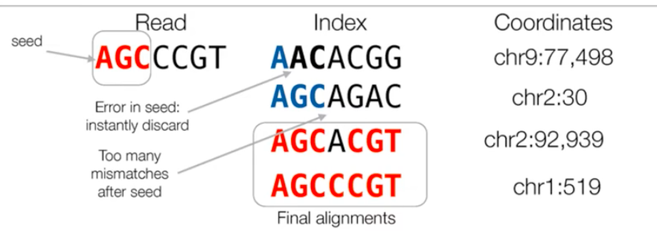
Alignment

Slide 12
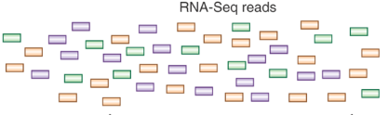
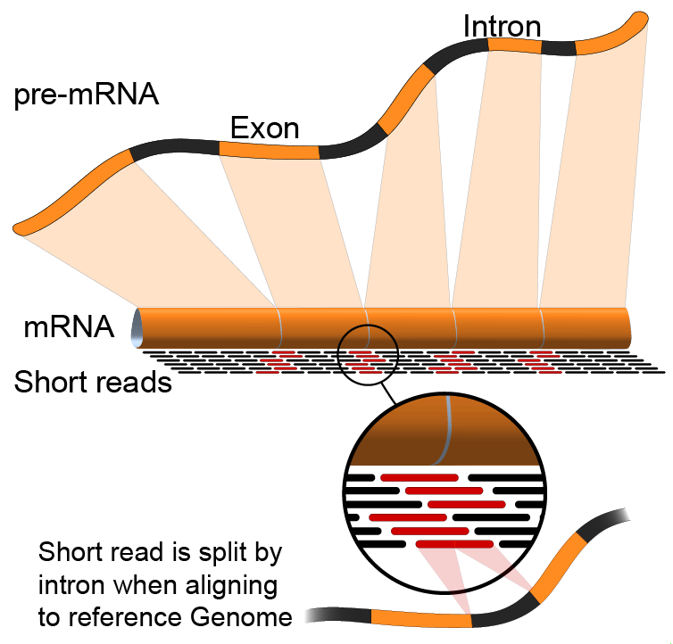

Alignment
Referance Transcriptome database
Referance genome database

Slide 13
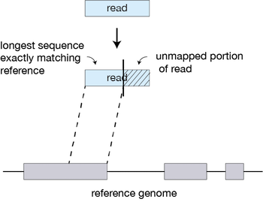
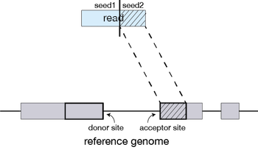
Splice aware alignment “STAR”
Maximal Mappable Prefixes (MMPs)

Slide 14
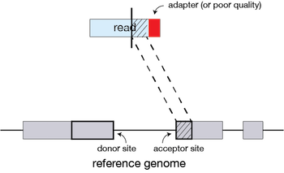
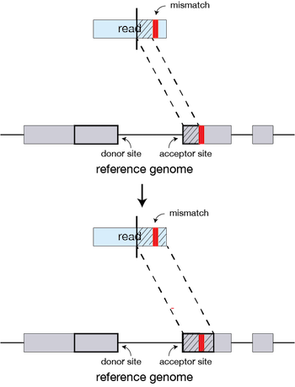
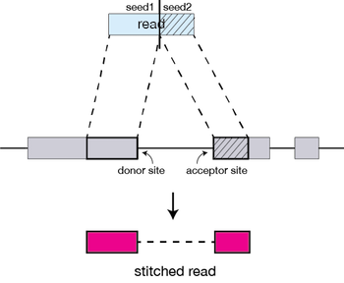
Splice aware alignment

Slide 15
Pseudoalignment
حضركتم دولقتى قدترو تهفمو اللى مكوتب على السيلاد حى لو مش مرتبت

Slide 16
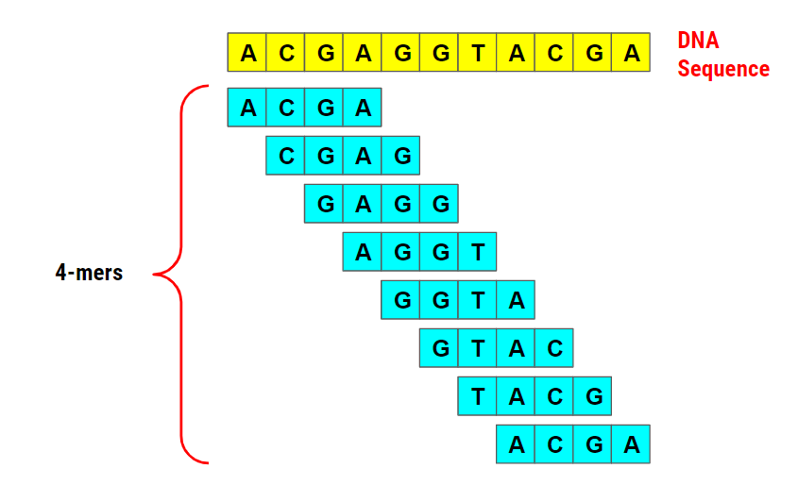
K-mear

Slide 17
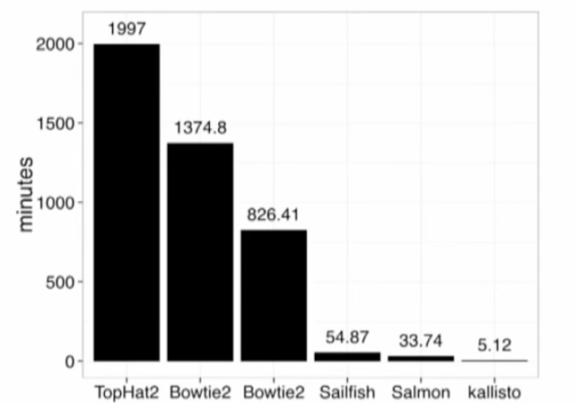
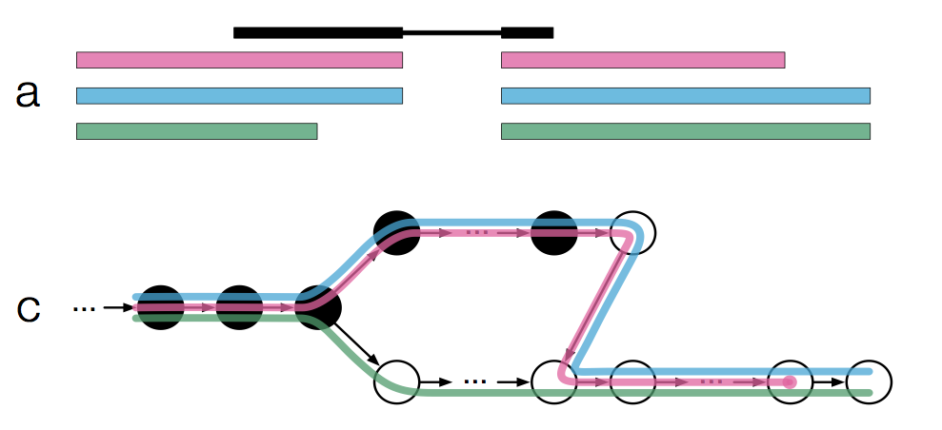
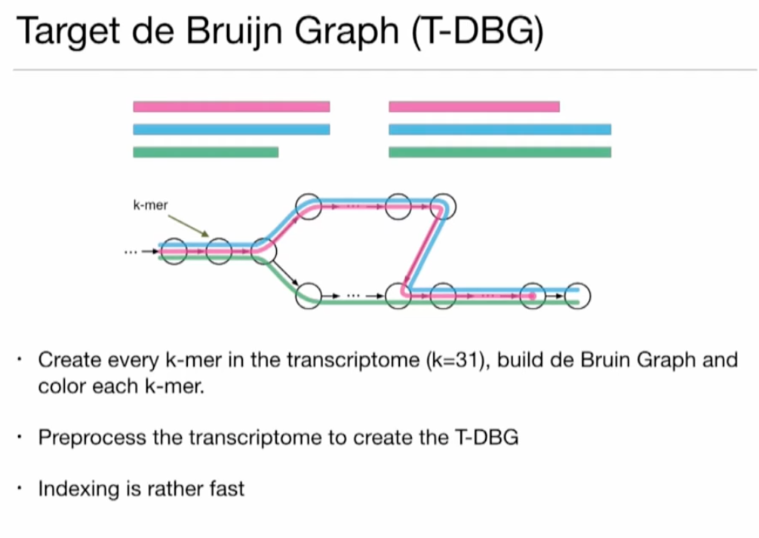
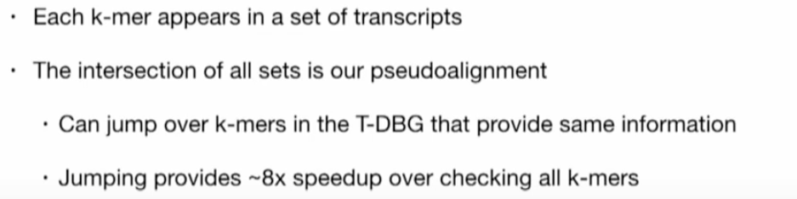
Pseudoalignment (Kallisto)

Slide 18
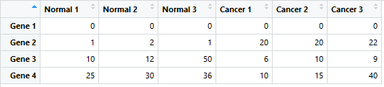
RNA-seq differential expression workflow
Reference genome
ATCGGACGTAGCACCTAGTTCCAGGTATGCCCTTGG
Reference genome + Annotation file
Gene 1
Gene 2
Gene 3
Gene 4
Sample 1
Count matrix
Sample 2
Control1 Control2 Control3 SC2_1 SC2_2 SC2_3
(M Oweda 2020)

Slide 19
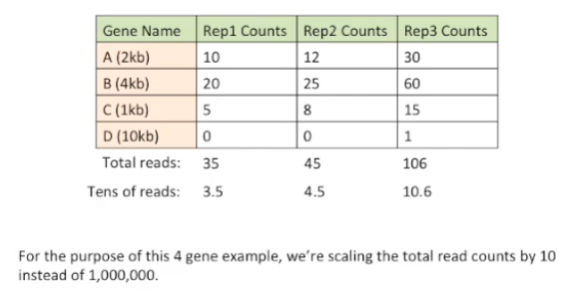
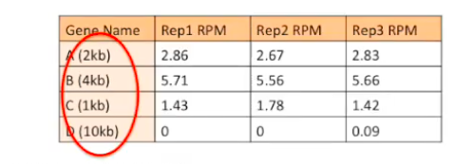
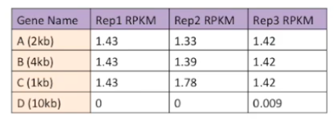
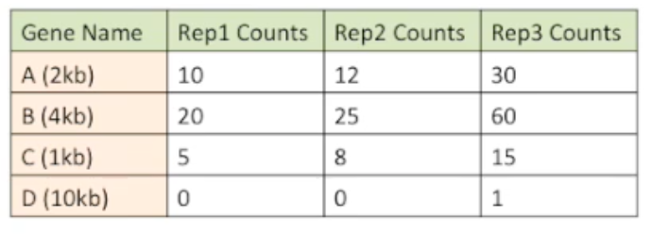
RPKM
Adjust length

Slide 20
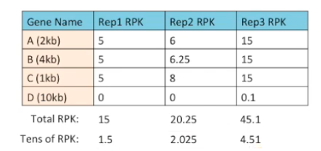
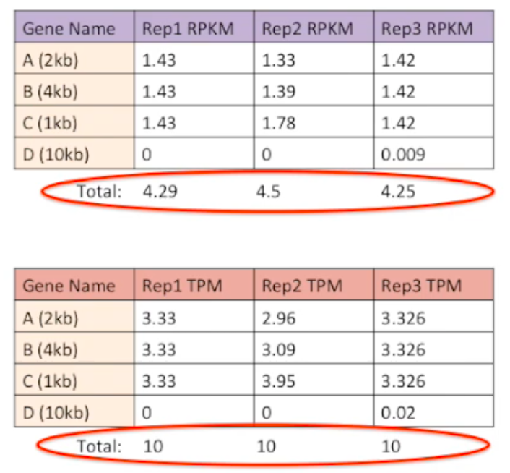
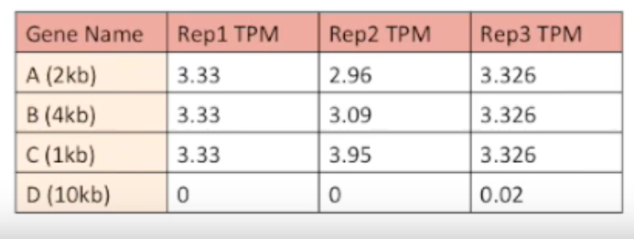
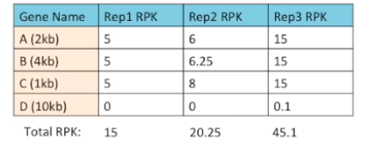
TPM
10 10 10

Slide 21
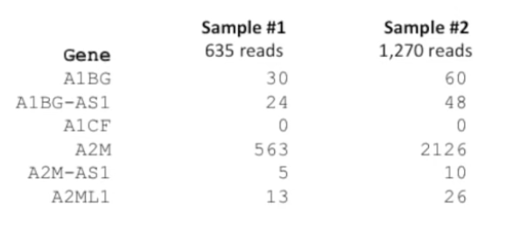
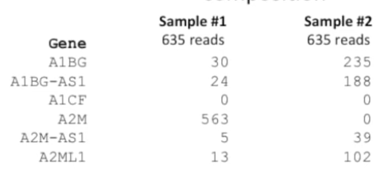
Sequencing depth and composition

Slide 22
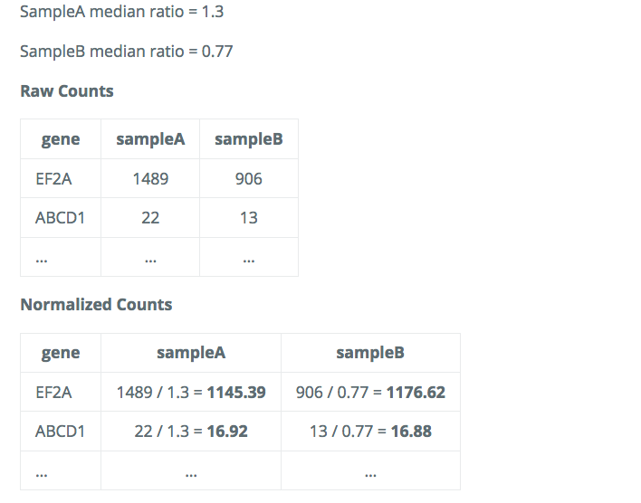
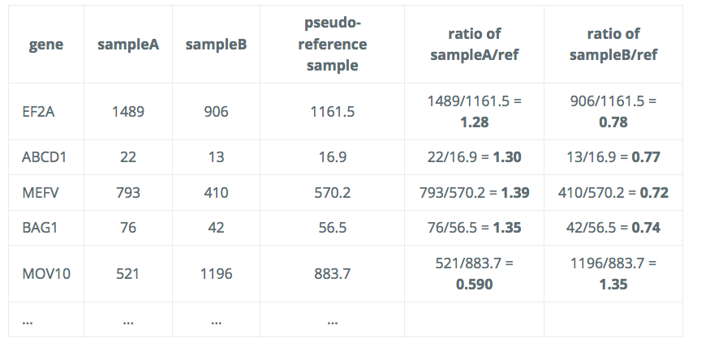
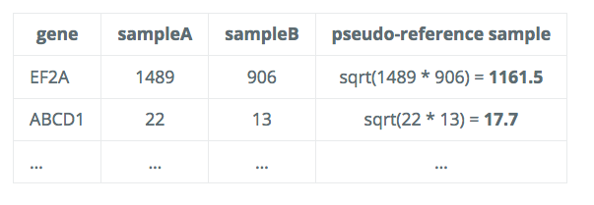
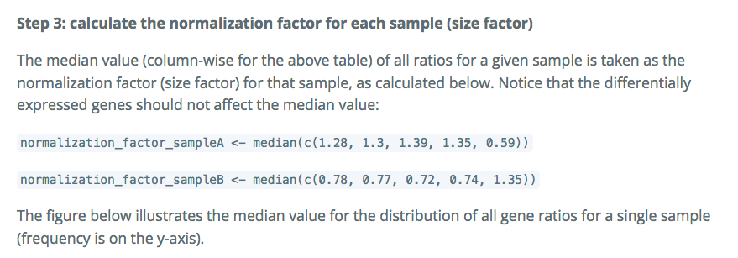
Median of ratios method

Slide 23
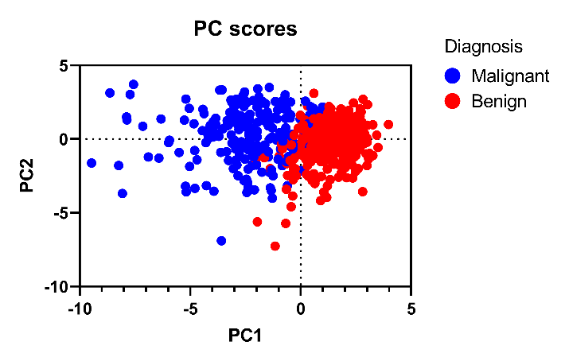
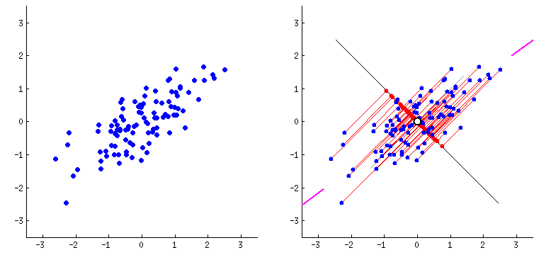
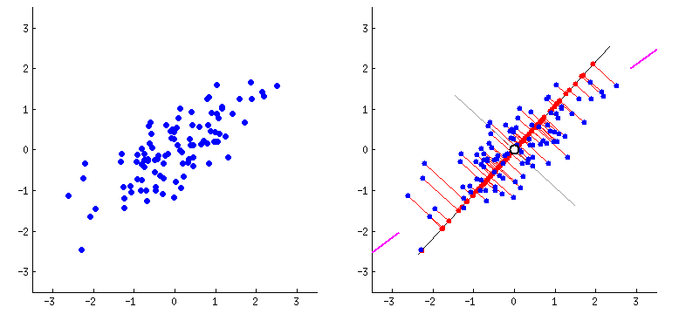
Matrix factorization (e.g. PCA)
Gene 1
Gene 2

Slide 24
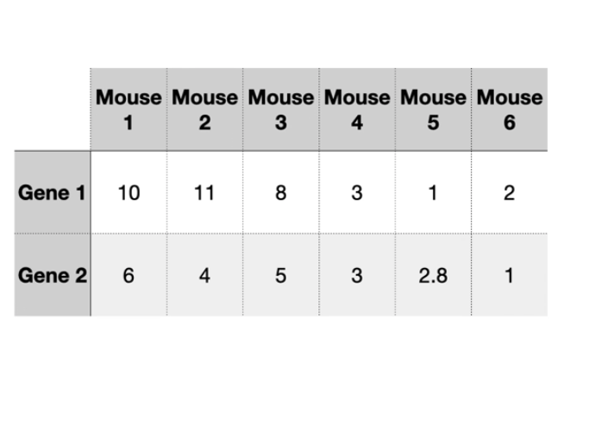

Slide 25
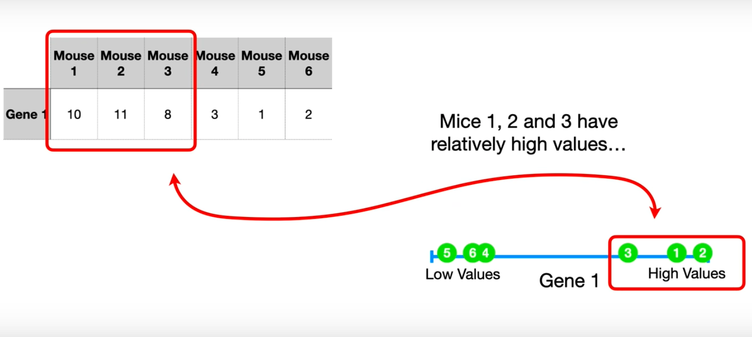

Slide 26
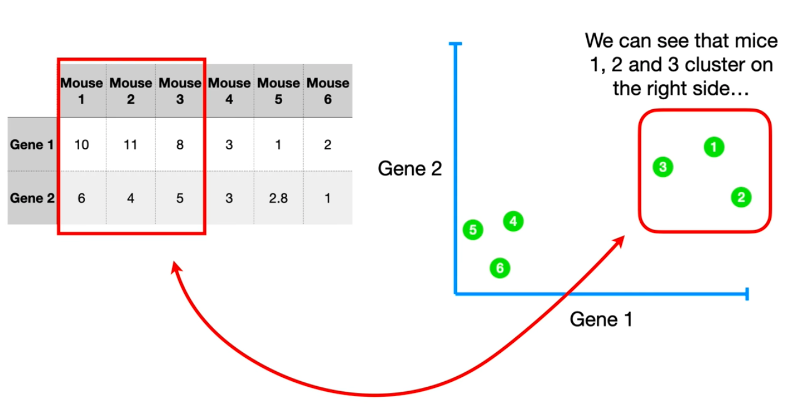

Slide 27
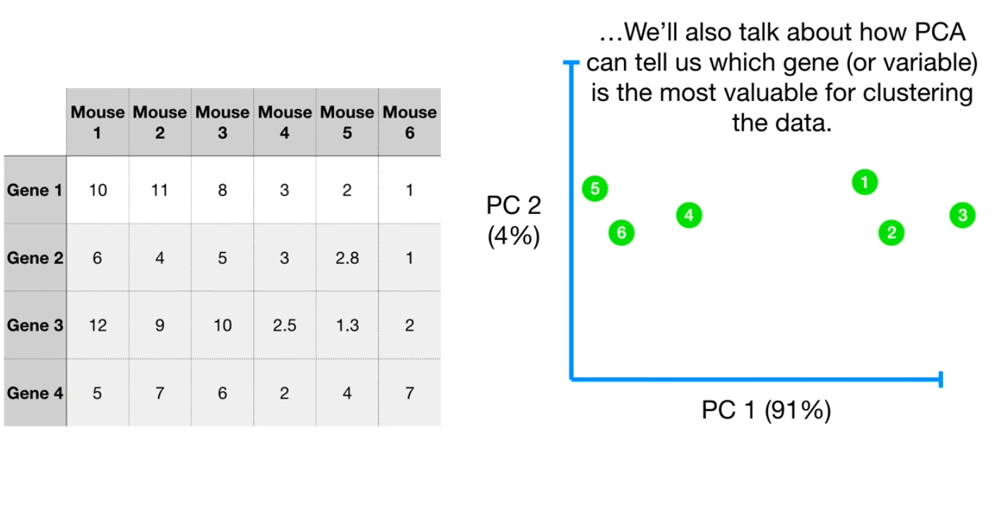

Slide 28
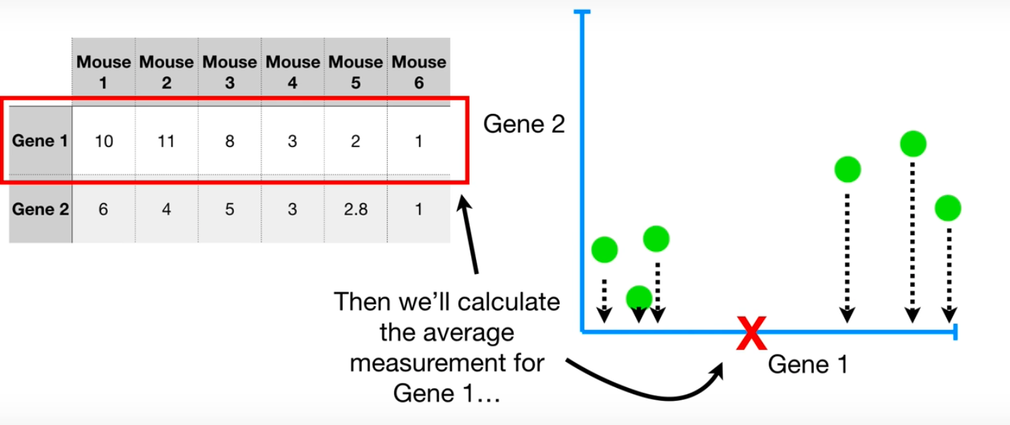

Slide 29
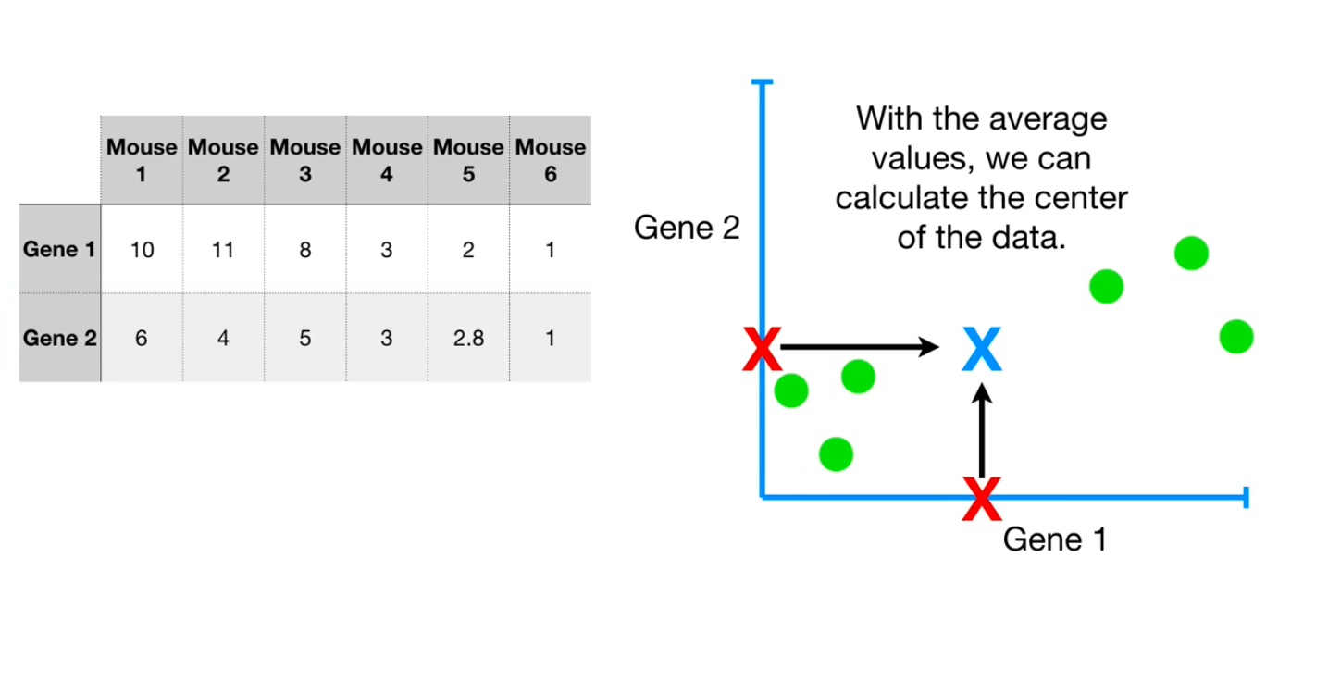

Slide 30
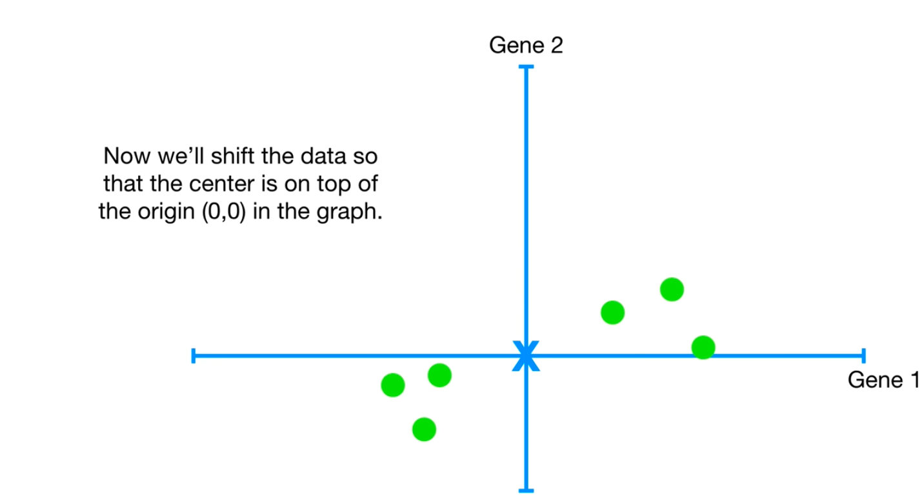

Slide 31
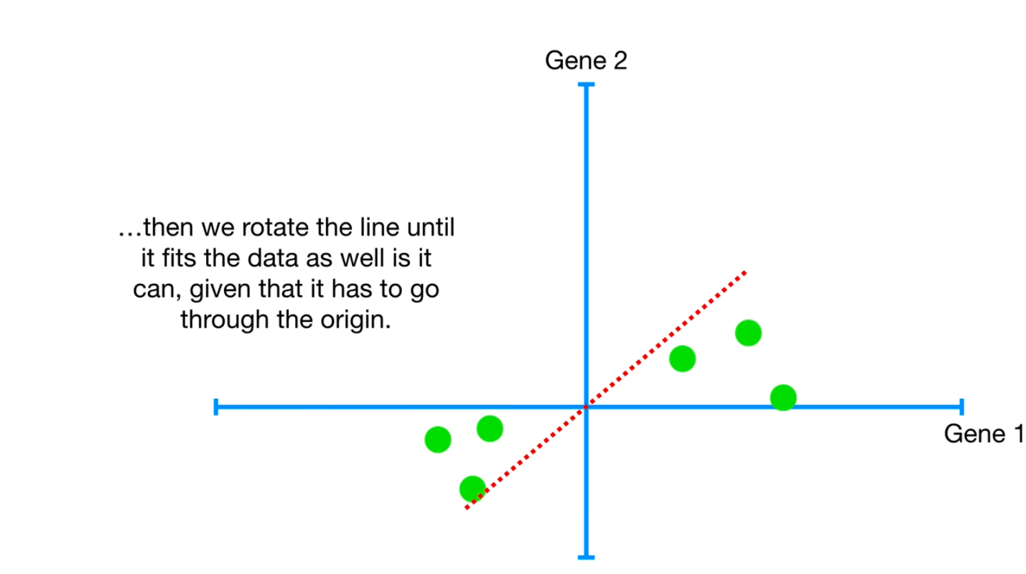

Slide 32


Slide 33


Slide 34


Slide 35


Slide 36


Slide 37


Slide 38


Slide 39


Slide 40


Slide 41


Slide 42


Slide 43


Slide 44
RNA-seq differential expression workflow
Reference genome
ATCGGACGTAGCACCTAGTTCCAGGTATGCCCTTGG
Reference genome + Annotation file
Gene 1
Gene 2
Gene 3
Gene 4
Sample 1
Count matrix
Sample 2

Slide 45


Dataset
(Mick E et al., 2022)
Notes:
Standridize the scaleing between the plots

Slide 46




Transcriptome analysis for child

Slide 47
Practical part
Hands on part on R
https://www.online-ide.com/?utm_content=cmp-true

Slide 48
Acknowledgment
Note: This presntation is infulanced by Statquest, DATAtab and MSc Mariam Oweda.

